Slide 1

Social Hierarchy in the UK and the US
E6 – File 3

Slide 2
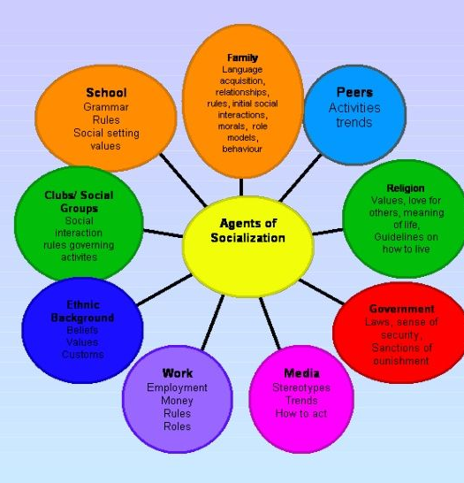
LESSON PLAN
Session 1 – Discussing Social Hierarchy Today
Provide an overview of the current state of social hierarchy both in the UK and in the US
Session 2 – Comparative Perspectives
Explore the similarities and differences between the UK and the US in terms of social structures
Session 3 – Historical Context and Evolution
Analyse the historical roots of social hierarchies in both countries and their evolution over time

Slide 3
DEFINITION
wealth
race
education
age
occupation
place
HIERARCHY implies ranking from top to bottom.
SOCIAL suggests the hierarchy concerns the members of a society.
SOCIAL FACTORS
https://www.britannica.com/topic/hierarchy-social-science
https://dictionary.cambridge.org/dictionary/english/hierarchy
https://www.merriam-webster.com/dictionary/hierarchy
https://www.oxfordreference.com/display/10.1093/oi/authority.20110803095935499

Slide 4
EXAMPLES
Social classes: upper / middle / working classes
wealth
race
education
age
occupation
place
Minorities: Afro-Americans / Hispanics…
North / South
East / West / Middle-West
Countryside / cities
Public Schools: Oxbridge & Ivy League
CEOs / factory workers
Gender gap
The City

Slide 5
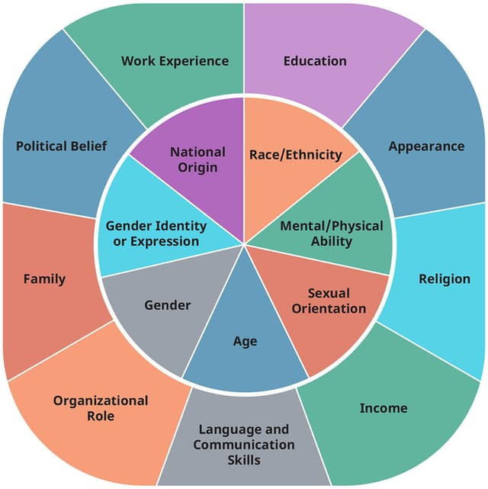
KEY CONCEPTS
SOCIAL MOBILITY
Ability to move up or down the social hierarchy
Intergenerational / intragenerational mobility
Barriers to social mobility: education, discrimination, resources
INTERSECTIONALITY
Interaction of different social identities: race, gender, class, sex
Policies like affirmative action

Slide 6
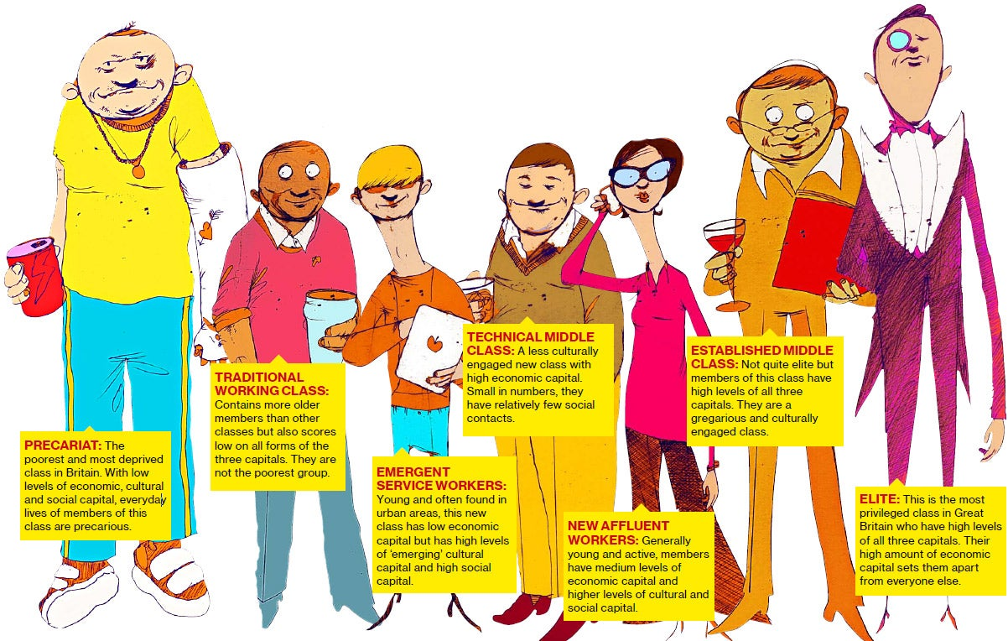
THE U.K SOCIAL CLASSES
3 traditional classes: upper / middle / working classes
The « precariat » class
The Great British Class Survey (GBCS-2011)
Social class indicators: occupation, lodging, regional accents

Slide 7
U.K EDUCATIONAL SYSTEM
State v. Public schools
Prestigious universities: Oxbridge
Public Schools Act, 1868
prestigious, fee-paying private schools
7 traditional public schools: Eton, Harrow, Winchester, Charterhous, Rugby, Shrewsbury, Westminster
Perpetuation of social hierarchy:
Admissions to top universities
Prestigious professions: FTSE 100 CEOs
Extra-curricular opportunities (= cultural capital)
Political leaders, royalty, and influential figures
Measures to counter educational inequalities:
Widening Participation Programmes
Free School Meals and Pupil Premium

Slide 8
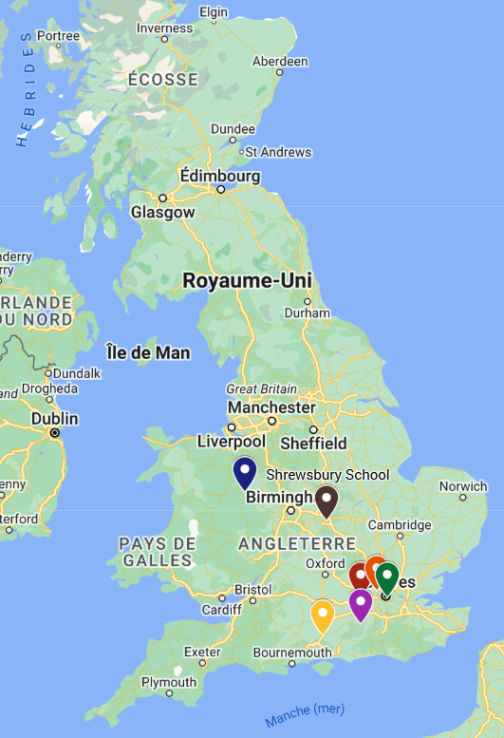
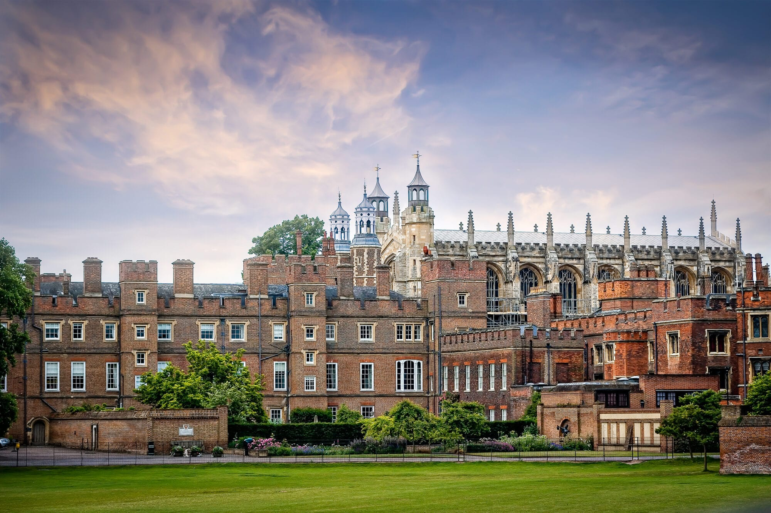
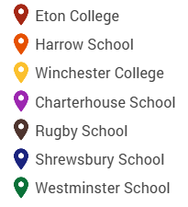
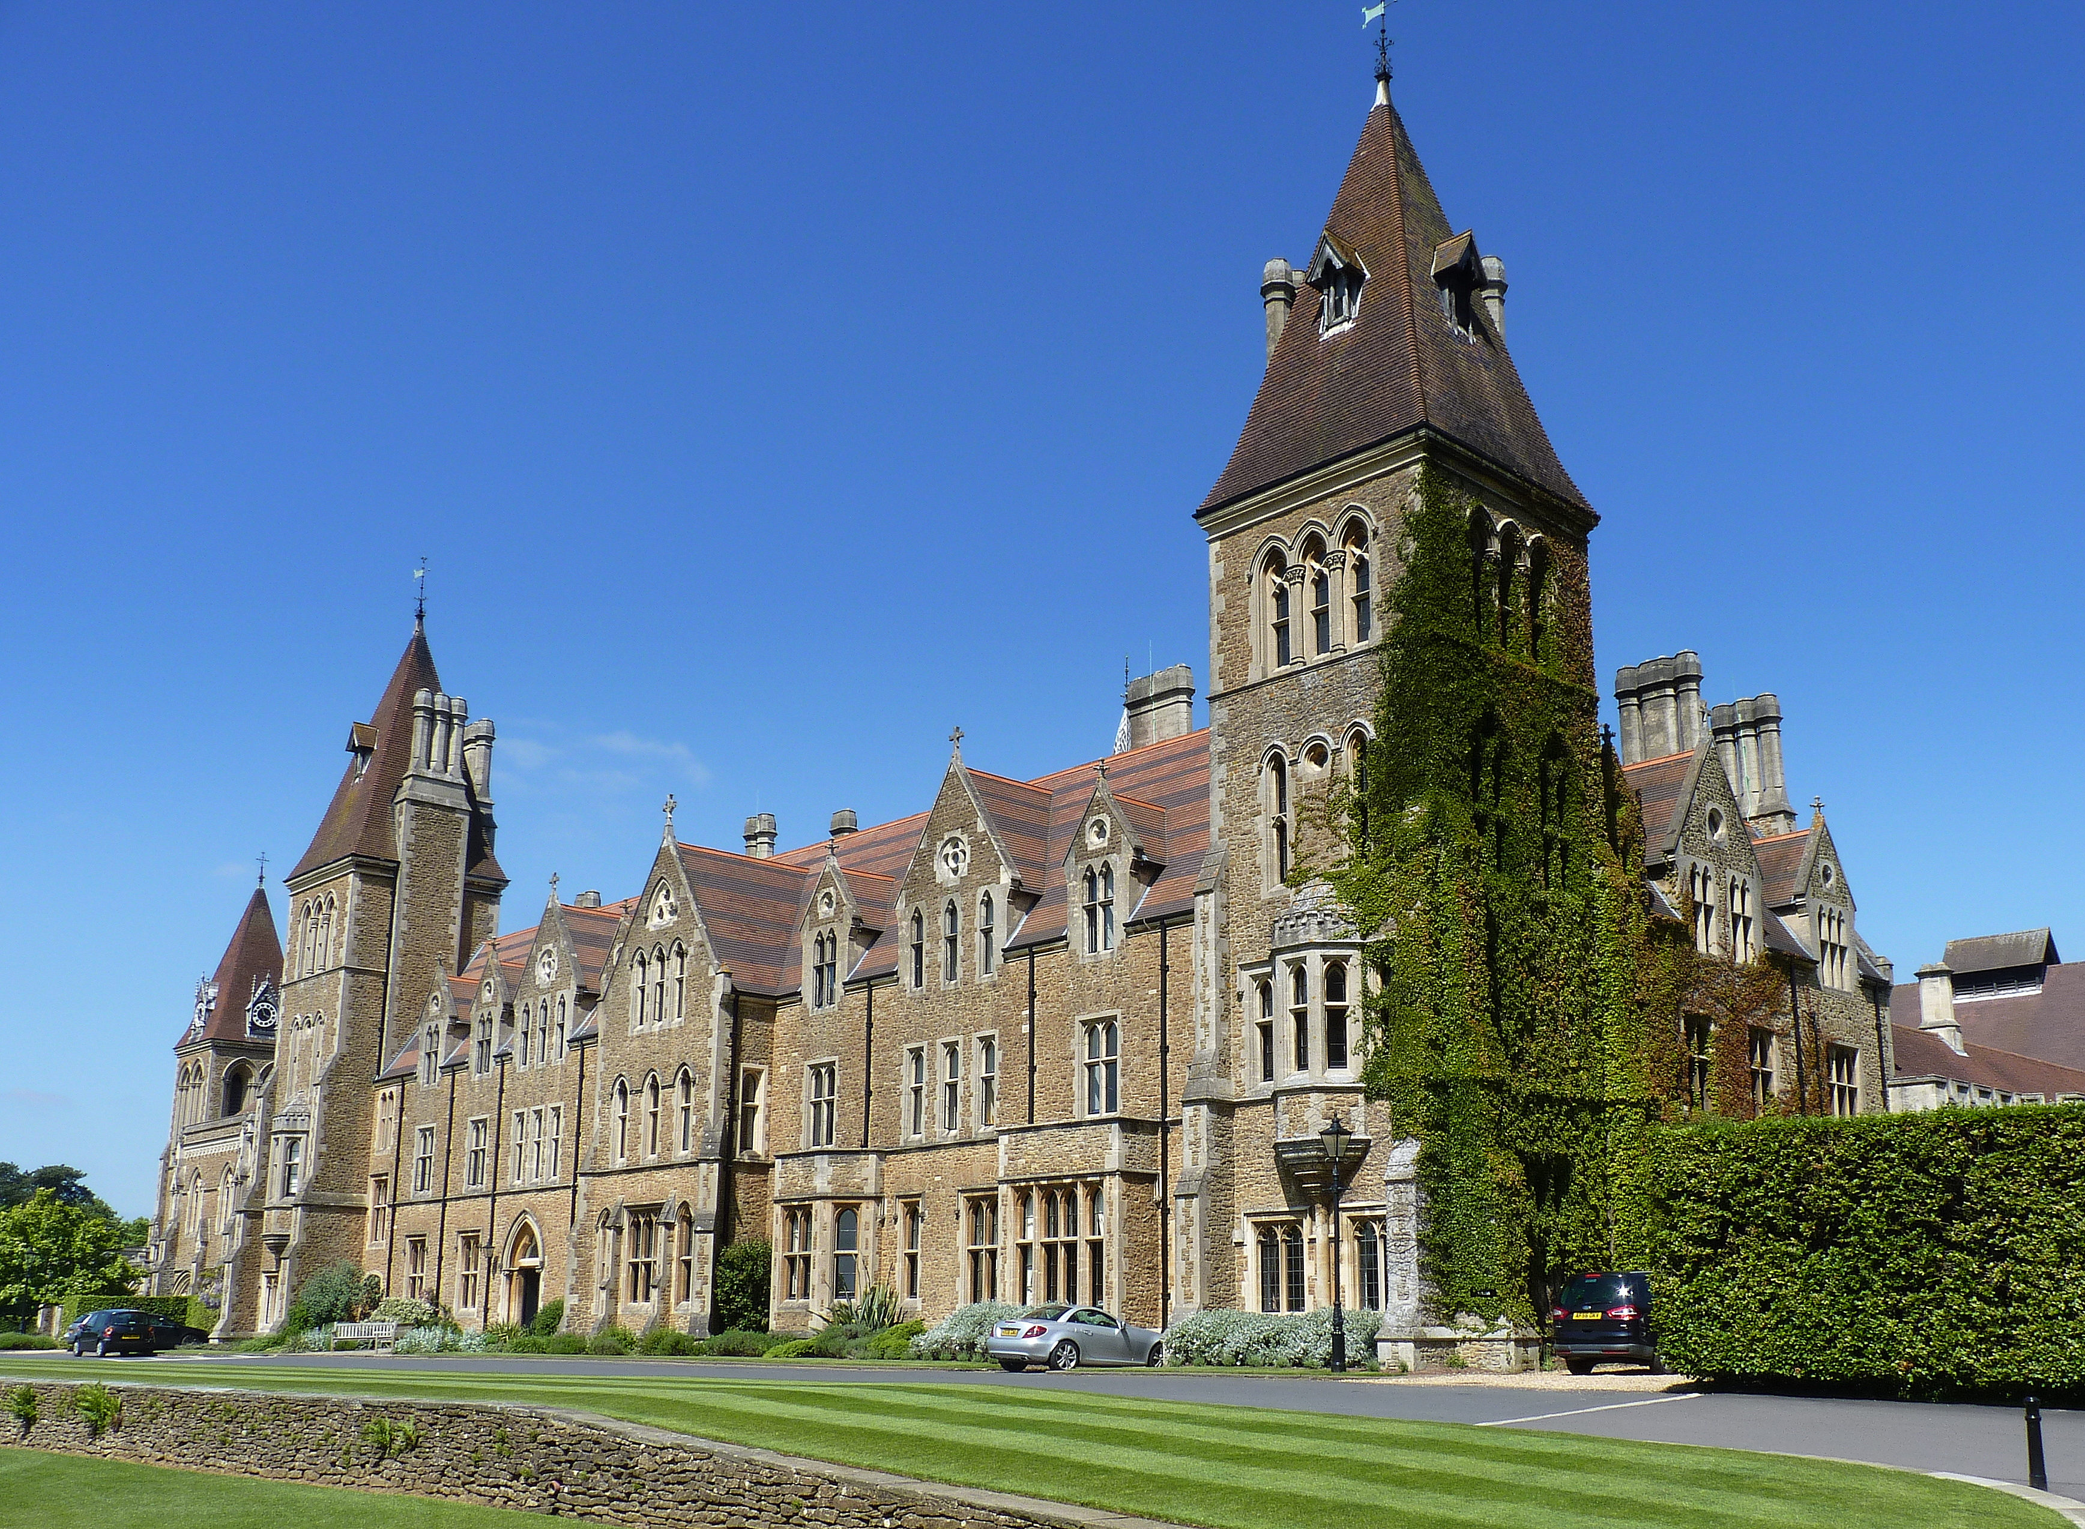
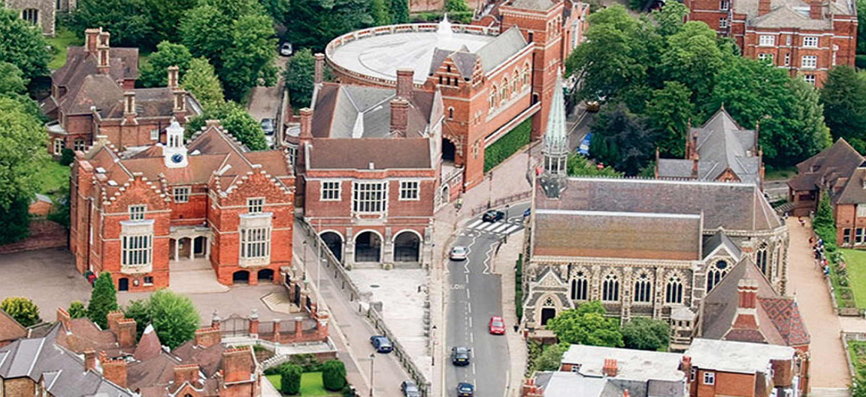
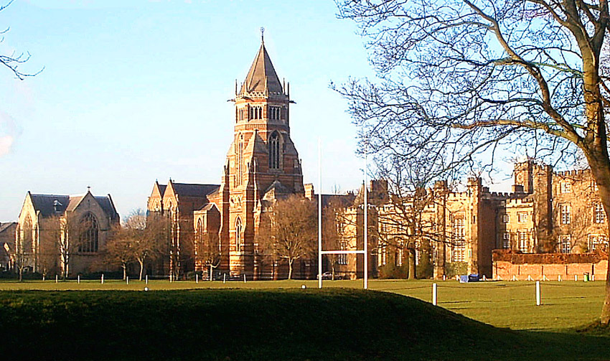
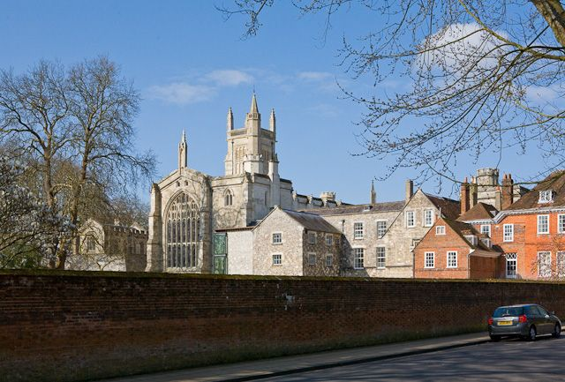
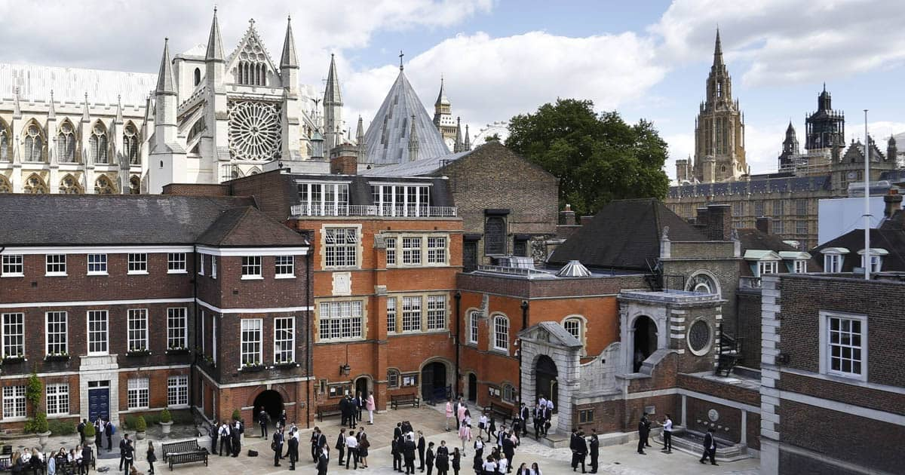
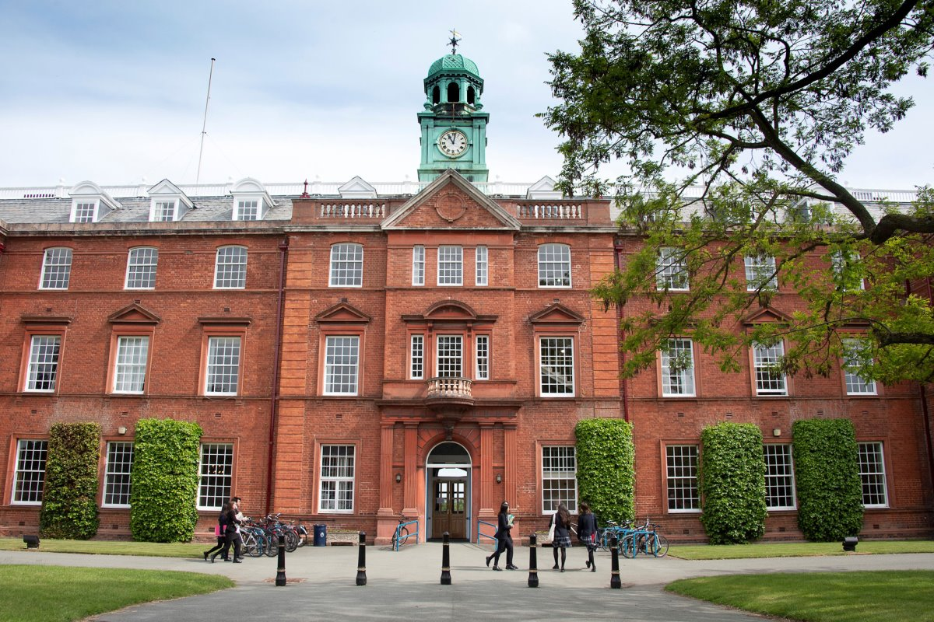

Slide 9
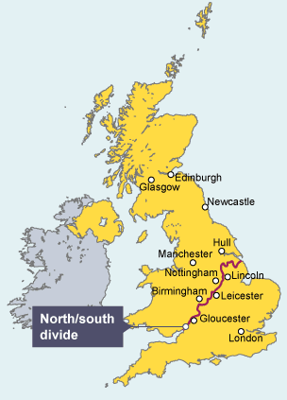
REGIONAL DISPARITIES
The North-South divide
The South
Greater access to high-paying jobs
Better infrastructure & investment (Oxbridge)
The economic hub of the U.K (the City)
The North
Former industrial areas: economic recession
Higher unemployment rate
Lower-paying jobs
Less funding on education
Leeds & Manchester: exceptions (economic hubs)

Slide 10
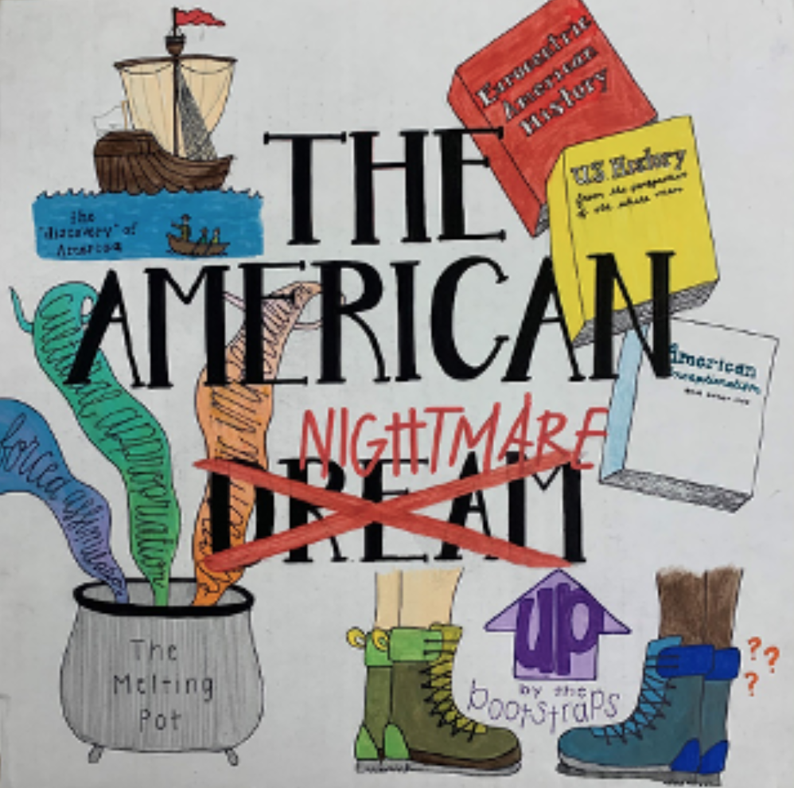
THE AMERICAN DREAM: Then and… now!
James Truslow Adams, The Epic of America, 1931
America as a refuge, a dreamland
better, richer and fuller life
Opportunities for each regardless of background
Ideals of freedom, democracy & equality
Modern challenges
- Inequalities: income, education, housing, employment
A nightmare for some…
Racial & ethnic disparities
Gender inequality
immigration

Slide 11
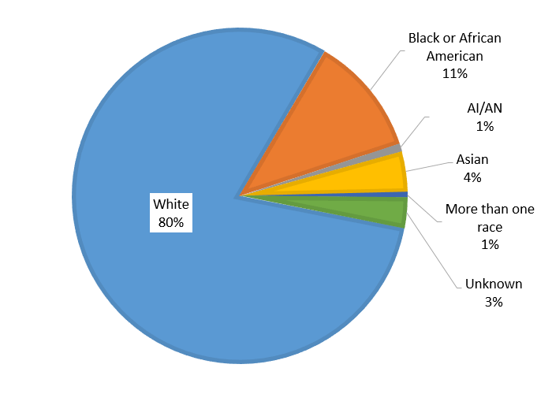
THE ROLE OF RACE AND ETHNICITY
A country built on immigration
Colonial America
Blacks, Hispanics, Natives, Asians → multiculturalism
Long-lasting historical practices
Slavery & Jim Crow Laws → segregation
The Trail of Tears → removal of Indian tribes
Chinese Exclusion Act (1882)
Race & social hierarchy
1960s Civil Rights Movement
Marker for social, economic & political status
Poverty, unemployment, incarceration, lack of education, discrimination

Slide 12
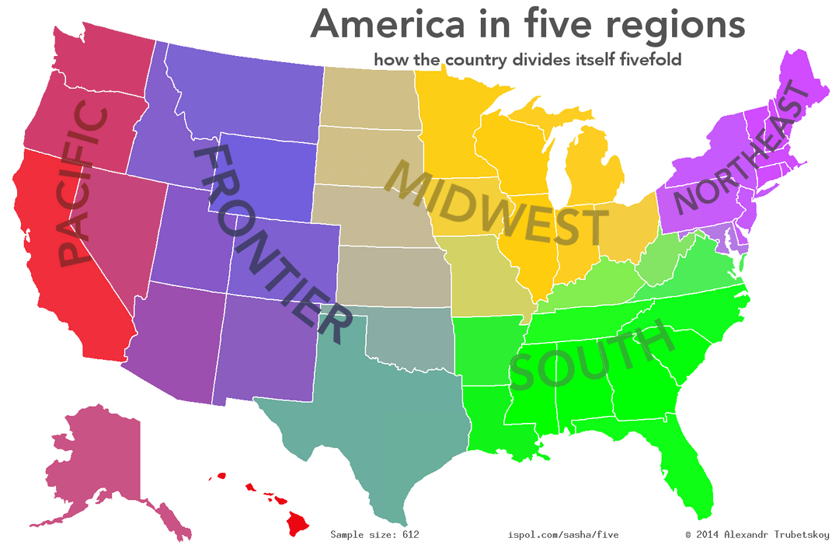
U.S REGIONAL VARIATIONS
A vast country
- Climate & geography → economy & society
5 regions
The North-East
The Midwest
The South
The West-Pacific Coast
The Mountain West (or Frontier)

Slide 13
The North-East | The Midwest | The South | The West
Maine, Vermont, New Hampshire, Massachusetts, Rhode Island, Connecticut, New York, New Jersey, Pennsylvania | Ohio, Michigan, Indiana, Illinois, Wisconsin, Minnesota, Iowa, Missouri, North Dakota, South Dakota, Nebraska, Kansas | Delaware, Maryland, Virginia, West Virginia, Kentucky, Tennessee, North Carolina, South Carolina, Georgia, Florida, Alabama, Mississippi, Arkansas, Louisiana, Texas, Oklahoma | Pacific California, Oregon, Washington, Alaska, Hawaii | Mountain Montana, Idaho, Wyoming, Colorado, Utah, Nevada, Arizona, New Mexico
This region is known for its historical significance, its major financial and cultural hubs, and for its harsh winters and vibrant fall foliage. | This region is often referred to as "America’s Heartland." It is known for its agriculture, its manufacturing, and a strong sense of community. | This region is rich in cultural traditions, including music and cuisine. It is historically tied to agriculture (cotton and tobacco plantations) and the Civil Rights Movement. | It is a geographically diverse region, with deserts, mountains, and coastlines. It is known for innovation and its natural beauty. It has a strong cultural influence through Hollywood and tech industries.

Slide 14
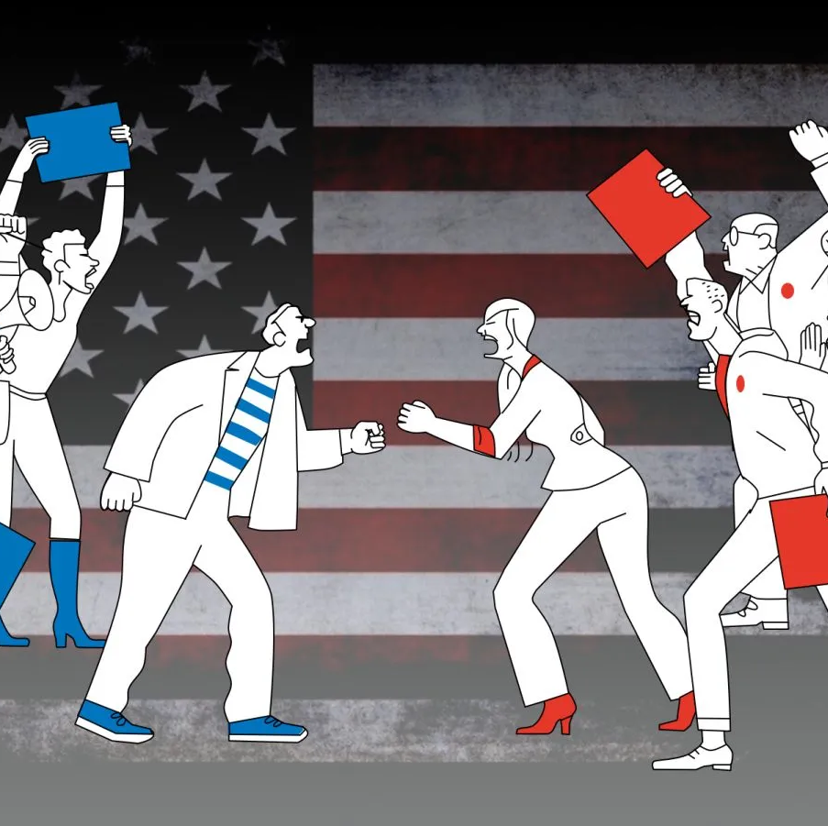
IMPACT OF REGIONAL DISPARITIES
Inequalities
Cultural, economic and political polarisation
Tensions and violence

